Slide 1
Fundamentals of
Digital Logic
Chapter 2
Notes:
Materials:
photomask
silicon disk
transistor from Sunfounder kit (S8050 is NPN)
7404 (NOT chip)

Slide 2
Terminology
current: the flow of electrons along a path
think of current as the number of electrons flowing through a wire during a particular time.
measured in amperes (A)
analogy: current is similar to the flow of water through a pipe
a high current would mean lots of water flow (fire hose)
a small current would mean very little water flow (dripping faucet)
Notes:
The type of wire (hose) has an effect on the flow of water -- larger diameter hoses can have a higher flow....larger diameter wires (or wires made of special metals) can have a higher flow
What else governs the water flow?? (Ask students -- looking for “water pressure”).

Slide 3
Terminology
voltage: is the difference in a quantity called potential between two points in the circuit
think of this as pressure that is forcing the electrons to flow
measured in volts (V), represented by the symbol V
analogy: voltage is similar to the water pressure in a pipe
high pressure will cause more water to flow, for the same size pipe
Notes:
But if you have low pressure, even if the faucet is wide open, you will only get a little water flow
This leads us to the relationship between voltage and current...

Slide 4
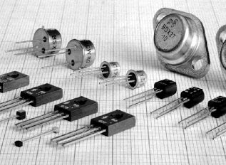
The Transistor
A device used to control the flow of current.
built using semiconductor materials, most often silicon
Each transistor functions like a small on/off switch, operated electronically.
Assemblies of transistors are the main component in computer hardware.
usually, transistors are printed inside of other chips

Slide 5
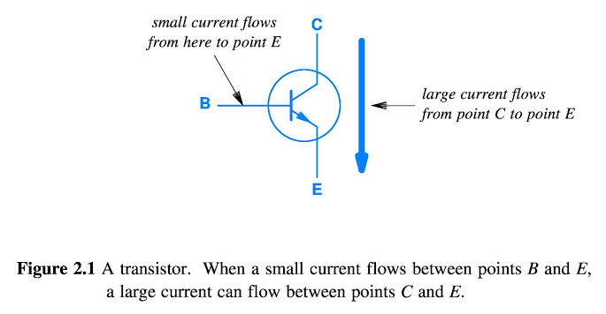
The Transistor
C = Collector
B = Base
E = Emitter
No current into B =
OFF (no flow from C to E)
Small current into B =
ON (larger flow from C to E)

Slide 6
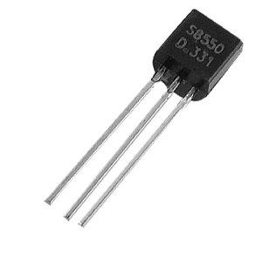
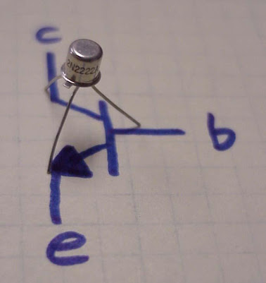
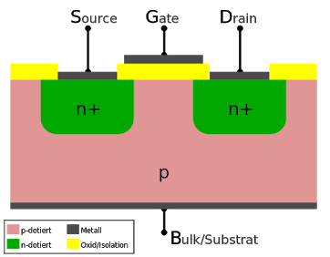
The Transistor
Notes:
There are different transistors for different purposes -- we will learn how to use them
(There are whole semester-long courses that just study the properties of transistors...)
S8050 is an NPN transistor (most common)
2N700 is a MOSFET transistor (more specialized purpose)
Two images on the left are macro level views -- we have the S8050 (pictured is S 8550).
Each of the 3 wires corresponds to the Collector, Base, and Emitter
At the micro level, there are layers of different materials (usually silicon based) that cause the transistor to function the way it does.
http://electronics.howstuffworks.com/diode.htm

Slide 7
Transistors and Boolean Logic
How do transistors allow computers to function?
We represent everything in binary:
5 volts represents a 1 (true)
0 volts represents a 0 (false)
If we consider 1 as true and 0 as false, then we can represent Boolean logic functions in hardware
Boolean functions are used to perform computer operations
Notes:
we call the hardware versions of Boolean logic functions “logic gates”

Slide 8
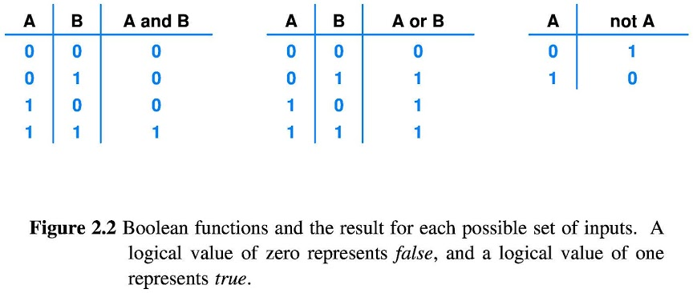
Boolean Functions
Notes:
Each of these functions can be built ENTIRELY in hardware, using transistors!

Slide 9
Logic Gates
Logic gates are Boolean functions wired in hardware
Usually we don’t use transistors individually, but rather we use integrated circuits, which have transistors, resistors, and other components in one “integrated” package
Notes:
Show a 7404 chip -- 6 boolean NOT logic gates.

Slide 10
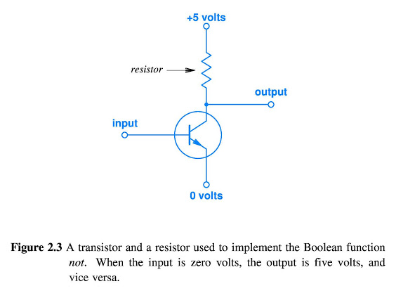
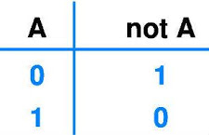
Boolean Hardware: NOT Logic Gate
Input/Output lines:
5 V represents 1 (true)
0 V represents 0 (false)
Input
Output
Notes:
The +5 at the top is a power source, the 0V at the bottom is ground.
The resistor limits the amount of current flow, so that the output is not exactly 5 V. (Without the resistor, too much current would flow at the 5V potential, possibly damaging other circuit components.)
If 0 is on the input, then the switch is OFF, and no current will flow through the transistor, and all the current coming from +5 will go to the output (1)
If 1 is on the input, then the switch is ON, and current WILL flow through the transistor, and NO current will go to the output (0). Think of the transistor in this case as a wire, so that the output is connected directly to the 0 (ground).

Slide 11
Boolean Functions in Hardware
The Boolean NOT is usually called an inverter, since it inverts (flips) the signal.
Circuits usually use the inverse Boolean functions NAND (not AND) and NOR (not OR), because it takes fewer transistors to implement them in hardware.

Slide 12
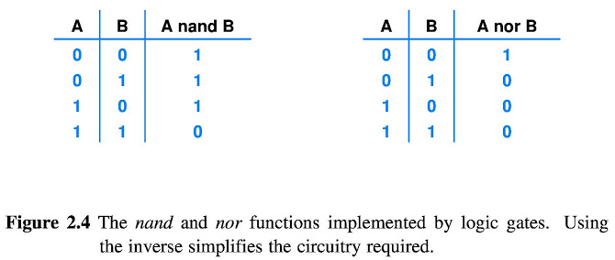

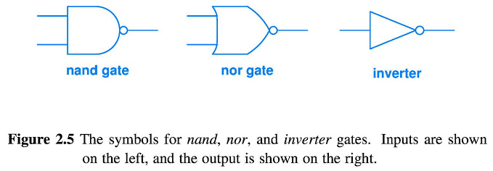
Digital Logic Gates
Notes:
Talk through the truth tables, and draw a few nand/nor gates that show how they work.
SINGLE gates only, at this point (combinations of gates later!)
IMPORTANT NOTE: Little circle, don’t forget they are the N in the NAND/NOR gate, without it is just and/or
Other NOTE: NAND and NOR are different shapes….

Slide 13
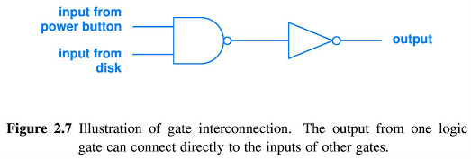
Boolean Logic in Hardware
Transistor-Transistor Logic (TTL): transistors connected together to perform a logic calculation
Notes:
Expression after truth table: Not(A nand B) --- simplified A and B
Walk through: call power button X, input from disk Y
(X nand Y) .... inverted, so:
NOT (X nand Y)
Write truth table:
X Y (X nand Y) not(X nand Y)
0 0 1 0
1 0 1 0
0 1 1 0
1 1 0 1
If power button is pressed while disk is spinning, output a 1 (start disk stopping logic)
NOT NAND = AND
Would a NOR work? Walk through. Results:
If the power-off button has NOT been pressed and the disk is NOT spinning, the output will be a 0
otherwise, the output will be a 1.
If the disk is spinning, and the user presses the power-down button, we will get an output of 1 (begin the disk-stopping logic)
The power button is pressed, disk is not spinning (begin disk stopping logic)...probably would add other components to prevent this
Power putton is NOT pressed and disk is spinning...begin disk stopping?? would need to prevent this

Slide 14
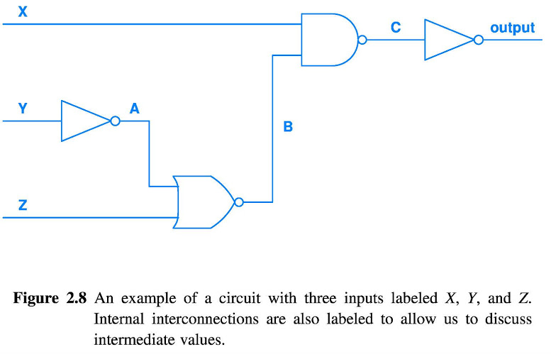
What Boolean formula is this?
Notes:
Truth Table B =(A nor Z) C =(X nand b) Output = (x and b)
X Y Z A B Out
0 0 0 1 0 0
0 0 1 1 0 0
0 1 0 0 1 0
0 1 1 0 1 0
1 0 0 1 0 0
1 0 1 1 0 0
1 1 0 0 1 1
1 1 1 0 1 0
Boolean Formula
ABC are just nicknames to make life easier, they don’t completely matter, INPUTS and OUTPUT are the most important, they are never in the final expression.
Not (((Not Y) Nor Z) Nand X)
Start with NOT Y it then inputs into a nor so put (Not Y) nor Z
Then that inputs into Nand, so (((Not y) Nor Z) nand x)
And it is all not, so do Not(((Not y) Nor Z) nand x)
Then can simplify into ((Not Y)Nor Z) and X
write on wires
(not Y)
(Z nor (not Y))
(X nand (Z nor (not Y)))
(not (X nand (Z nor (not Y))))
NOT NAND = AND
X and (Z nor (not Y))
write truth table --> a column for X Y Z A B C output
(answer on next slide --write then check!)

Slide 15
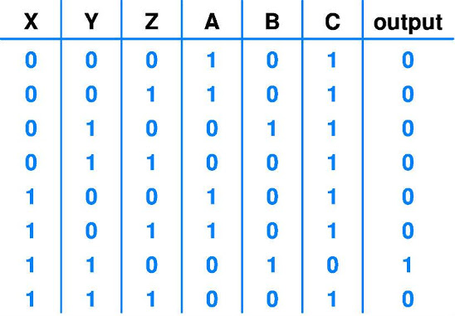
What Boolean formula is this?
Notes:
Can also write as:
X and Y and (not Z)

Slide 16

Checkpoint 1.1
(a) Write the Boolean Logic expression for the following diagram:
(b) Also write the truth table.
X
Y
A
B
C
Z
Notes:
solution in handwritten notes
Work in groups of 2 or 3, turn in your work

Slide 17
Checkpoint 1.2
(a) Draw a circuit that represents this Boolean Logic:
(((not X) nand Y) nor Z)
(b) Draw the corresponding truth table
Notes:
Solution in handwritten notes
Write truth table too!
Work in groups of 2 or 3, turn in your work

Slide 18
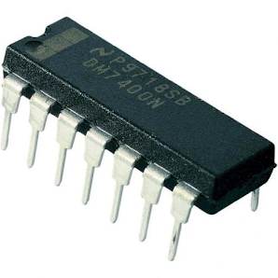
Multiple Gates per Integrated Circuit
The 7400 series of chips have 14 pins (wires) that connect to a circuit. Two pins are for power (+5V and ground)
7400 has 4 nand gates
7402 has 4 nor gates
7404 has 6 inverters
Notes:
why are there more inverters than nand/nor gates??
-- nand and nor have two inputs and one output -- 3 wires per gate. with 14 pins that gives us room for 4 gates (plus power/ground)
-- not gates have one in and 1 out, leaving room for more
Some pins are not part of the gates, but used to provide power to the circuit.
7400 are for hobbies, gates are much smaller nowadays

Slide 19
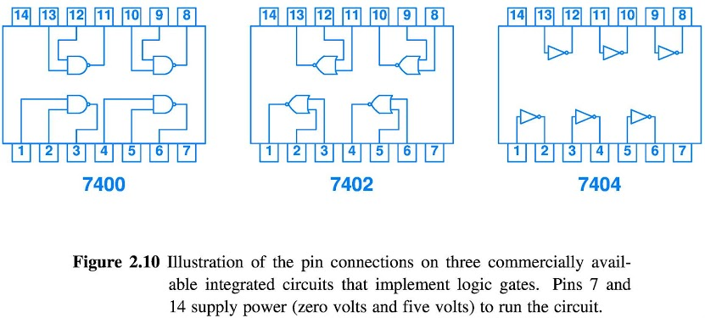
Multiple Gates per Integrated Circuit
Notes:
There are other logic chips, but these are pretty common for hobbies and logic project

Slide 20
Combinatorial Circuits
Combinatorial circuits are circuits that have output that is a Boolean combination of input values.
However, we need an additional functionality:
the ability to maintain state (store a value)
the ability to continue to operate after the input reverts to the initial condition.
Notes:
when we press the power button to turn the computer on, we press it AND RELEASE IT, and the computer performs the steps for a boot. We do NOT have to hold the power button down the entire time it is booting.

Slide 21
Circuits that Maintain State
Boolean circuits cannot hold a constant value, unless the inputs to the circuit remain unchanged.
Several types of circuits maintain state: they respond according to history of previous input values
not just the current value.

Slide 22
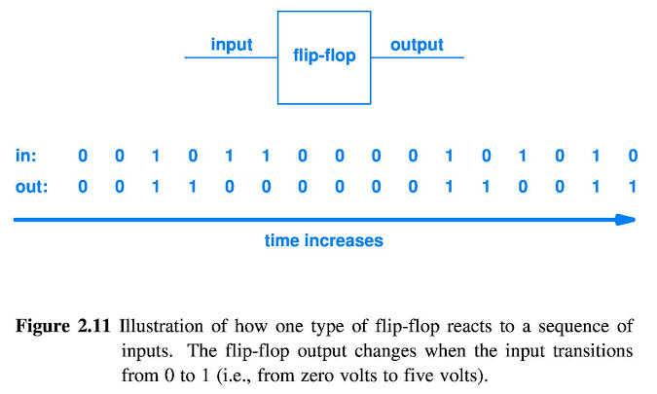
Flip-flop
Notes:
note that we have to have a 0 before a 1 in order to get a change of state
circle the transitions, or draw the equivalent

Slide 23
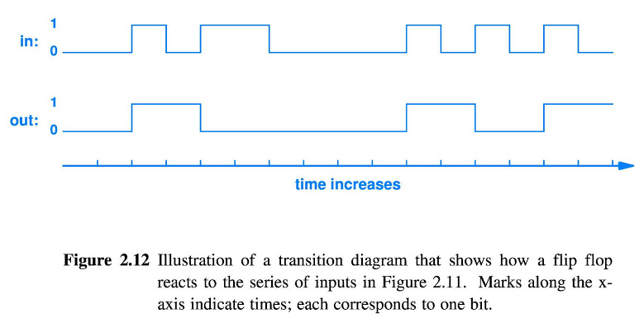
Transition Diagrams
Transition diagrams plot the input and output as a graph, to make it easier to visualize the transitions of devices such as a flip-flop.
Notes:
We can see that the output changes on the “leading edge” of the input signal...from 0 to 1.
Some circuits transition on the change from 1 to 0, on the “falling edge”
Most flip-flops have a reset button that allows them to have the output directly set to 0.

Slide 24

Flip-Flop
The flip-flop maintains state:
the first time the input becomes 1, the flip-flop turns on the output
the second time the input becomes 1, the flip-flop turns off the output
the input must return to 0 between state changes
Receiving an input of 1 causes the output to “flip”.
Notes:
a continuous value of 1 will not cause a change in state. It must return to 0 before the state will change.
Used for power buttons, store/create memory,
Nand memory:
FLIP FLOP ARE MAIN BUILDING BLOCK OF RAM MEMORY

Slide 25
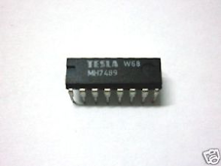
Binary Counters
A counter keeps track of the number of inputs:
output changes when input transitions from 0 to 1
multiple outputs lines represent the total count of transitions in binary
Notes:
Rather than having only two outputs -- a 0 and 1, like a flip-flop, the counter has more

Slide 26
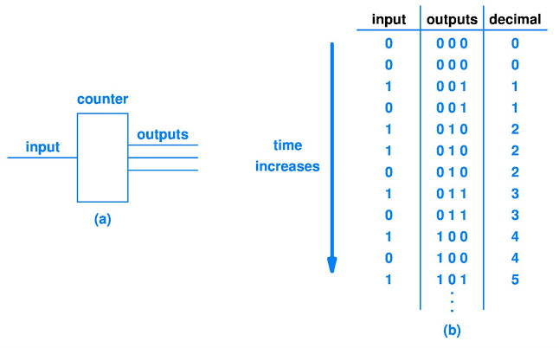
Binary Counters
Notes:
We will cover binary in more detail in the next chapter
Write on the board: 1 input = 0 0 1 on outputs
2nd input = 0 1 0 on outputs
0b1001 – 1 * 2^3 + 1 * 2^0 = 8 + 1 *1 = 9
0b1101 – 1 * 2^3 + 1 * 2^2 + 1 * 1 = 13

Slide 27
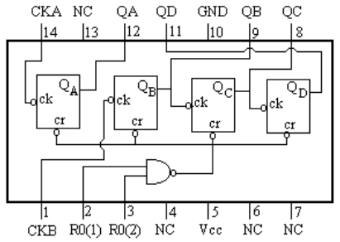
Binary Counters
A limited number of output pins mean that the counter has a maximum value.
If the value exceeds the maximum, the counter has another output that indicates an overflow occurred.
Notes:
I think that this is a 3-bit binary counter, and Output D is the overflow indicator...which can be used to make it a 4 bit counter, but you cannot detect overflow then.

Slide 28
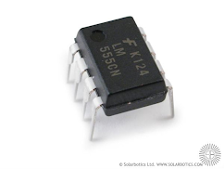
Clocks
A clock is a device that outputs a sequence of 0’s and 1’s at a set rate, measured in Hertz (Hz) (which is the number of cycles per second).
A clock rate of 1 Hz basically means that the clock emits: 1 for half a cycle (0.5 sec) and then 0 for half a cycle (0.5 sec).
Notes:
One clock is not often used, usually it is multiple, and then clock sync becomes an error

Slide 29
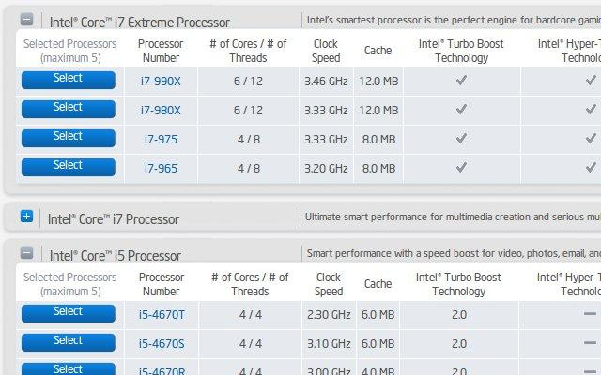
Notes:
giga = 1 billion (10^9)
mega = 1 million (10^6)

Slide 30
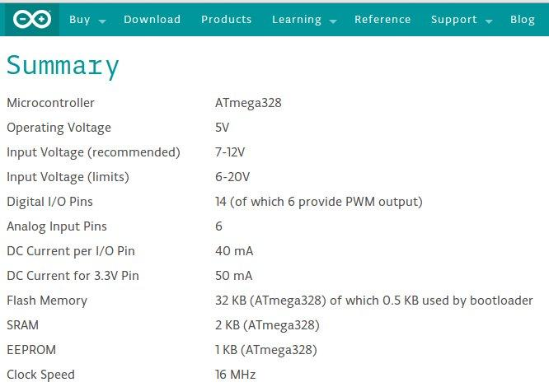

Slide 31
Clocks and Sequences
Suppose we want a circuit to perform 6 steps in order, 1 second apart, after receiving a single input:
test battery
power on and test memory
start disk spinning
power up the monitor
read boot sector from disk into memory
start the CPU
Notes:
say we want the next step to happen 1 second after the first.

Slide 32
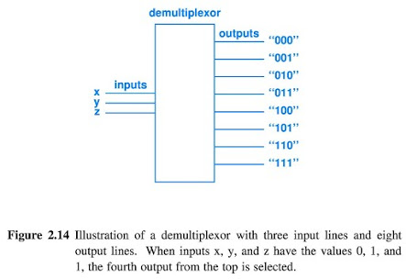
Clocks and Sequences
Need 3 devices:
clock
binary counter
demultiplexer (“demux”)
A demultiplexer uses binary input values to select a particular output line (all other outputs are off).

Slide 33
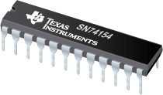
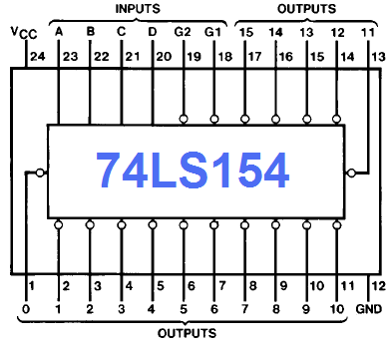
74154 Demultiplexer
4 line input to 16 line output

Slide 34
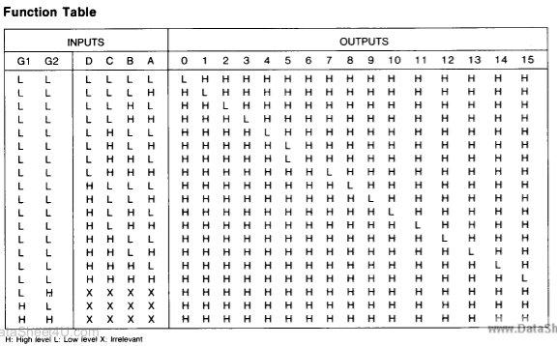
Notes:
Table is possibly wrong

Slide 35
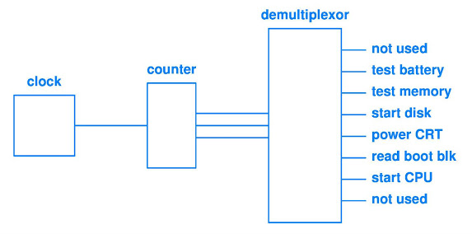
Clocks and Sequences
PROBLEM:
We cannot start or stop the sequence!
Notes:
Each output would be connected to another circuit that would handle the task
whenever the clock begins ticking, the sequence will begin....
and when the counter wraps around to 0, the sequence will restart!

Slide 36
Feedback
Feedback allows the results of processing to affect the way the circuit behaves.
In the previous example, we need to ensure that each step finishes before the next begins.
And, we need to be able to stop the booting process, when finished.
Notes:
In the computer startup example, we need feedback to ensure each step is finished before the next begins.

Slide 37
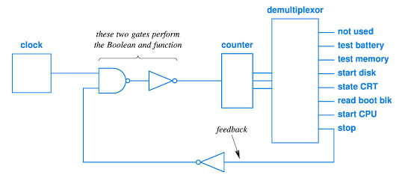
Feedback Example: Stopping
We can use the last output of the demultiplexer as a feedback loop:
add a NAND/NOT (which is an AND)
1 on the feedback loop turns off the counter.
Notes:
walk through logic, writing on the diagram.
Boolean Logic:
CLOCK and (not F)

Slide 38
Feedback Example: Starting
How can we start the booting process?
Most counters IC’s have an additional input that resets the output to all zeros.
We can connect the power button to this input
When the demux receives 000, it will turn off the last output, and turn on the first input
This resets the feedback loop to 0, turning on the NAND/NOT gate pair.
The boot process would then begin.
Notes:
The problem is: what if the user gets restless and pushes the button again, before we are finished?
Then that could cause problems.
At the very least, we’d restart from the beginning.
At worst, the disk could have problems.
Most modern computers have more than just a direct line to the clock that controls the boot sequence!

Slide 39
Iteration in Software vs.
Replication in Hardware
In software, we write programs to handle multiple items through iteration:
while/for loops find the next item, then process it
limited to handling ONE item at a time.
In hardware, we build circuits to handle multiple items through replication:
create multiple copies of the gates, and allow each copy to act on one item.
all gates act at the same time, on MANY items (one per gate)
Notes:
This is counter-intuitive!
As programmers, we train you to avoid replication -- and use iteration whenever possible!
We don’t create 32 variables with different names, we create one array, and use a for loop to process each item, one after another.
In hardware, we would create 32 different (identical) paths, and then send one value through each path, in PARALLEL.

Slide 40
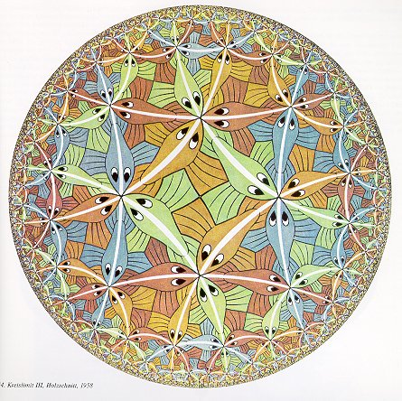
Hardware Replication
Advantages of replicating hardware:
replication hardware is more elegant than iteration hardware
iteration requires extra hardware to select one item, move it into place, compute it, then move the result back.
replication is easier to understand, design, build, debug, and use

Slide 41
Hardware Replication
Advantages of replicating hardware components:
replication hardware increases performance dramatically
all operations are performed simultaneously!
For example: calculating the Boolean NOT of 32 numbers
iteration -- takes 32 steps to calculate one at a time
replication -- all 32 are calculated in parallel, in one step
Notes:
increase in performance by a factor of 32!!!
parallelism is found throughout hardware...including the dual and quad-core processors!
bits of data received from memory are sent in parallel (memory bus)
bits of data sent to disk to be written are sent in parallel
By understanding how it works in hardware, we can take advantage of it in software

Slide 42
Gate and Chip Minimization
The drive for replication is balanced by a need for minimization:
circuit elements consume power and generate heat
smaller chips are physically faster (electrons do not have to travel as far)
chips with fewer gates are less expensive to produce
Notes:
Computer engineers write Boolean expressions, then look for ways to simplify subexpressions, in order to eliminate gates.
Sometimes simplification does not minimize the circuit: say we rearrange a boolean expression that originally has 4 nand gates, so that it needs just 2 nand gates and 1 nor gate...that enlarges the circuit, because we now need a second chip!

Slide 43
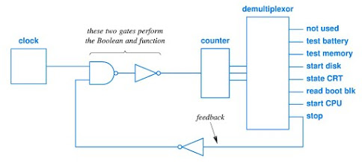
Using Spare Gates
Sometimes it’s advantageous to use spare gates in an existing chip.
This circuit seems to need two chips: a NAND chip and a NOT chip.
But, we can build NOT gates from NAND gates.

Slide 44
Group Problem Solving
How can we reproduce a NOT gate with a NAND gate?
Notes:
-Tie one of the inputs of a NAND gate to the +5V line (Boolean 1), then the gate will function like a NOT gate.
-Tie the input (e.g., A) to both inputs of the NAND.
Work in groups of 2 or 3, turn in your work

Slide 45
Using Spare Gates
Note that (1 NAND x) = NOT x
If we tie one of the inputs of a NAND gate to the +5V line (Boolean 1), then the gate will function like a NOT gate.
Notes:
draw a NAND gate, with one input tied to +5V....and show that as an inverter.

Slide 46
Power Distribution and Heat Dissipation
All electrical devices consume power, and computer engineers need to consider how to deliver this power (and have a large enough power supply).
All electrical devices that consume power generate heat.
The amount of heat generated is proportional to the power consumed.
High temperatures cause electronics to fail, so we need to ensure that heat dissipation is sufficient for each design.

Slide 47
Timing
Circuit operations take a finite amount of time:
a gate does not act instantly, but takes time to settle (change the output after the input changes)
signals (current) take time to travel through the system: the length of wire between the clock and the IC determines when a clock signal arrives
Clock skew: when the difference in signal travel time causes a problem in a circuit.
Notes:
1 foot of wire takes 1 nanosecond of travel time.... an 18 inch motherboard can have a difference of nearly 1.5 nanoseconds
usually this is solved with multiple clocks, located physically close to the components that they controll...but then you need to synchronize the clocks!

Slide 48
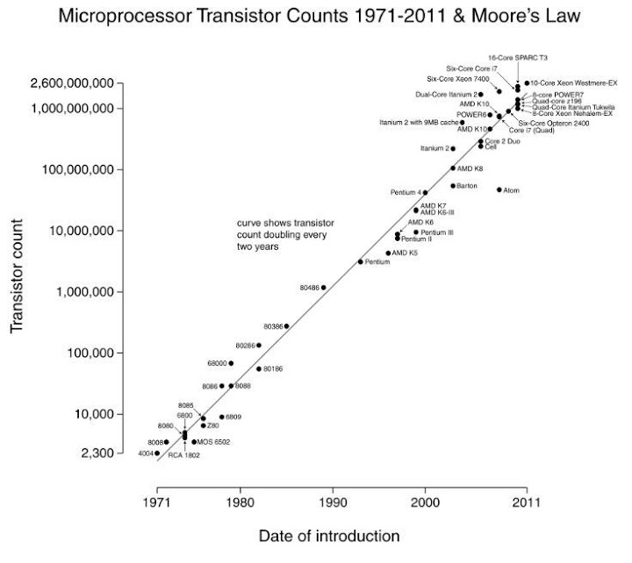
Moore’s Law
Gordon Moore, cofounder of Intel observed in 1965 that the density of transistors per square inch, had doubled every year, historically.

Slide 49
The Limit of Moore’s Law
“In terms of size [of transistors] you can see that we're approaching the size of atoms which is a fundamental barrier, but it'll be two or three generations before we get that far—but that's as far out as we've ever been able to see. We have another 10 to 20 years before we reach a fundamental limit. By then they'll be able to make bigger chips and have transistor budgets in the billions.” (Moore, 1995)

Slide 50
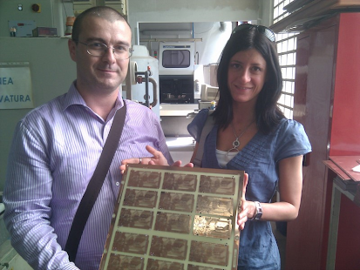
Circuit Boards and Layers
Most production circuits are built by connecting components to a printed circuit board:
fiberglass layer (often green)
thin metal strips printed on the surface
holes for connecting IC’s,
resistors, capacitors, etc
can be printed in layers (up to about 18) to allow proper connections to be made
Notes:
these to folks are holding printed arduino boards

Slide 51
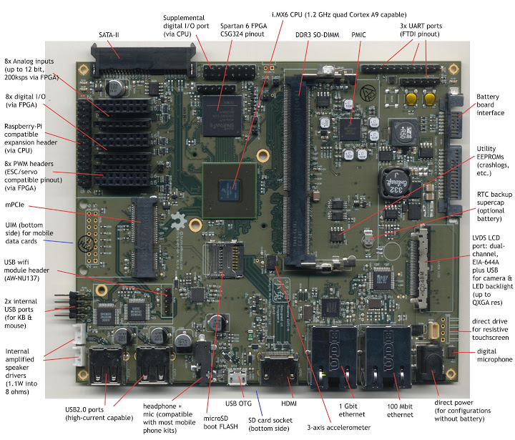
Circuit Boards and Layers
http://www.bunniestudios.com/blog/?p=2686
Notes:
http://www.bunniestudios.com/blog/?p=2686
this is a home built motherboard, open source hardware.

Slide 52
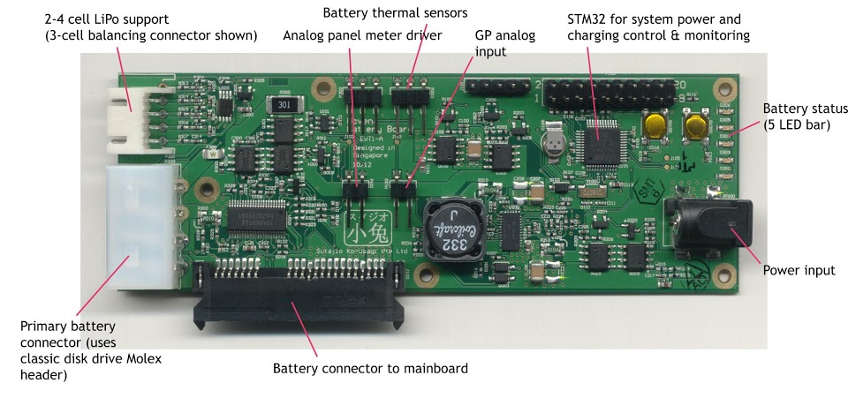
Notes:
Power management and connection to battery.

